Slide 1

Exploring the Talent Pool in Kolkata Job Market
A Comprehensive Analysis

Slide 2
Slide 1: Introduction
To make informed hiring decisions :When you have a good understanding of the talent pool, you can better assess the qualifications and skills of potential candidates. This can help you to make more informed hiring decisions and avoid making costly mistakes.
To identify and attract top talent : In a competitive job market, it is important to be able to identify and attract top talent. By understanding the talent pool, you can develop targeted recruiting strategies that will reach the right candidates.
To develop a talent pipeline: A talent pipeline is a group of qualified candidates who are interested in working for your company. By building a talent pipeline, you can ensure that you have a pool of qualified candidates to draw from when you need to fill open positions.
To stay ahead of the curve : The job market is constantly changing, and it is important to stay ahead of the curve. By understanding the talent pool, you can identify emerging trends and ensure that your hiring practices are aligned with the latest market conditions.
Kolkata, the capital of West Bengal, is one of the most important job markets in India. It is home to a diverse range of industries, including IT, manufacturing, agriculture, and education. The city also has a large pool of skilled and qualified workers.
Here are some of the reasons why Kolkata is a significant job market:
Diverse economy: Kolkata has a diverse economy, which provides a variety of job opportunities for job seekers. Some of the major industries in Kolkata include IT, manufacturing, agriculture, and education.
Skilled workforce: Kolkata has a large pool of skilled and qualified workers. The city is home to several prestigious universities and colleges, which produce many graduates every year.
Favorable government policies: The West Bengal government has implemented several favorable policies to promote entrepreneurship and business development. This has led to the creation of new job opportunities in the state.
Affordable cost of living: Kolkata has a relatively affordable cost of living compared to other major cities in India. This makes it an attractive destination for job seekers.

Slide 3
Slide 2: Overview of Kolkata Job Market
Information technology (IT),
Manufacturing,
Agriculture,
Education,
Healthcare,
Logistics,
Tourism.
The current economic scenario in Kolkata is positive, with the city experiencing steady growth in recent years. The city's GDP is estimated to be around $160.2 billion (PPP) as of 2022, making it the third richest city in India after Mumbai and Delhi.

Slide 4

Slide 3: Population Demographics
Kolkata, the capital of West Bengal, is the seventh most populous city in India with an estimated city proper population of 4.5 million (0.45 crore). It is the center of the Kolkata Metropolitan Region (KMR), one of the most populous metropolitan areas in the world with a population of over 15 million (1.5 crore) residents.
The population of Kolkata is relatively young, with the median age being 28.8 years

Slide 5
Slide 4: Industry-wise Talent Distribution
Breakdown of talent distribution across major industries
Identify the key sectors with high-skilled professionals

Slide 6
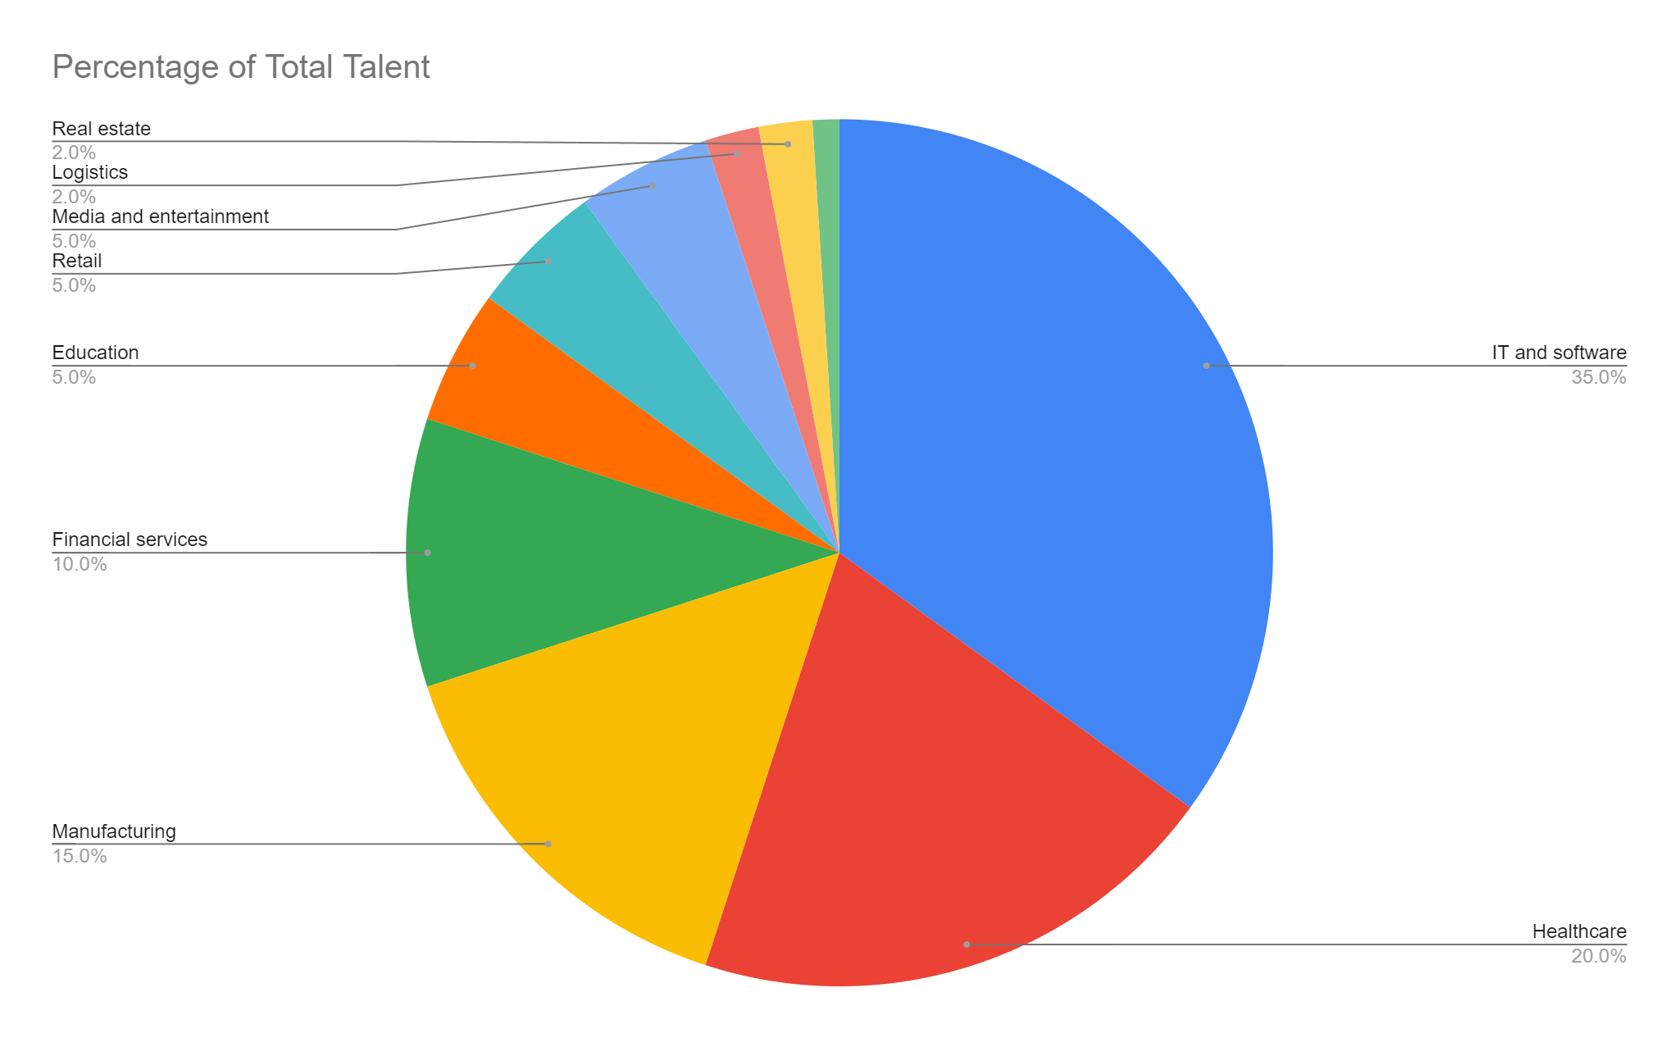

Slide 7
IT and software:
Within the IT and software industry, the largest percentage of talent is employed in the following areas:
Software development (25%)
Web development (15%)
Mobile development (10%)
Data science and analytics (10%)
Cloud computing (10%)
Financial services
Within the financial services industry, the largest percentage of talent is employed in the following areas:
Banking (35%)
Investment banking (20%)
Insurance (15%)
Accounting (10%)
Financial planning (10%)
Healthcare:
Within the healthcare industry, the largest percentage of talent is employed in the following areas:
Nursing (35%)
Physicians (20%)
Allied health professionals (15%)
Healthcare administration (10%)
Pharmaceutical sales (10%)
Education
Within the education industry, the largest percentage of talent is employed in the following areas:
K-12 education (50%)
Higher education (30%)
Early childhood education (10%)
Adult education (10%)
Manufacturing:
Within the manufacturing industry, the largest percentage of talent is employed in the following areas:
Production (40%)
Engineering (20%)
Quality control (15%)
Supply chain management (10%)
Maintenance (10%)
Retail
Within the retail industry, the largest percentage of talent is employed in the following areas:
Sales (50%)
Customer service (20%)
Management (15%)
Marketing (10%)
Logistics (5%)

Slide 8
Media and entertainment
Within the media and entertainment industry, the largest percentage of talent is employed in the following areas:
Film and television (35%)
Music (20%)
Video games (15%)
Publishing (10%)
Advertising and public relations (10%)
Construction
Within the construction industry, the largest percentage of talent is employed in the following areas:
General contracting (40%)
Subcontracting (30%)
Other(30%)
Logistics
Within the logistics industry, the largest percentage of talent is employed in the following areas:
Transportation (50%)
Warehousing (20%)
Distribution (15%)
Freight management (10%)
Customs clearance (5%)
Real estate
Within the real estate industry, the largest percentage of talent is employed in the following areas:
Sales (50%)
Marketing (20%)
Management (15%)
Appraisal (10%)
Title insurance (5%)

Slide 9
Slide 5: Emerging Trends in the Job Market
Overview of current trends shaping the job market in Kolkata
Highlight any emerging sectors or industries

Slide 10
The job market in Kolkata is currently being shaped by several trends, including:
Growth of the IT sector
The IT sector is one of the fastest growing sectors in Kolkata and is expected to continue to grow in the coming years. This is creating a strong demand for IT professionals in the city.
Shift towards automation and digitalization
Many industries in Kolkata are shifting towards automation and digitalization. This is leading to a decline in the demand for some traditional jobs, and an increase in the demand for jobs that require digital skills.
Rise of the gig economy
The gig economy is growing in Kolkata, as more and more people are choosing to work as freelancers or contractors. This is providing workers with more flexibility and control over their work, but it is also making it more difficult for them to find stable employment and benefits.
Increasing focus on upskilling and reskilling
The job market in Kolkata is becoming more competitive, and employers are increasingly looking for candidates who have the skills and experience that they need. This is leading to an increase in the demand for upskilling and reskilling programs.
Growing importance of soft skills
In addition to technical skills, employers in Kolkata are also increasingly looking for candidates who have strong soft skills, such as communication, teamwork, and problem-solving skills.
Increased demand for women in the workforce
There is a growing demand for women in the workforce in Kolkata. Employers are recognizing the value of diversity and inclusion and are actively recruiting women for a variety of positions.

Slide 11
Government initiatives
The government of West Bengal is implementing several initiatives to promote employment and entrepreneurship in the state. These initiatives are expected to create new job opportunities in Kolkata.
These are just some of the trends that are shaping the job market in Kolkata. By understanding these trends, job seekers can better prepare themselves for the future and employers can make more informed hiring decisions.
Here are some tips for job seekers in Kolkata:
Focus on developing your technical skills and soft skills.
Stay up-to-date on the latest trends in your industry.
Be proactive in networking with people in your field.
Consider upskilling or reskilling to improve your job prospects.
Highlight your skills and experience in your resume and cover letter.
Be prepared to discuss your salary expectations.
By following these tips, job seekers can increase their chances of finding a job in Kolkata that is a good fit for their skills and experience.

Slide 12
Slide 6: Employment Opportunities
Highlight major companies and sectors with significant job openings
Discuss any recent developments or investments in the job market

Slide 13
Major companies and sectors with significant job openings
TOTAL 13202 Job found in Kolkata Including all sectors. ( Source Noukri.com, google jobs , LinkedIn)

Slide 14
Maximum companies looking for 2-4 years of experience

Slide 15

Slide 7: Challenges and Opportunities
Address challenges faced by both employers and job seekers
Identify opportunities for improvement and growth

Slide 16
Challenges
Limited job opportunities in some sectors: The Kolkata job market is dominated by a few key sectors, such as IT, manufacturing, and healthcare. This means that job opportunities are limited in some other sectors.
Skills mismatch: Many job seekers in Kolkata do not have the skills that are required by employers. This is due to several factors, such as inadequate education and training, and a lack of exposure to industry trends.
Competition: The Kolkata job market is becoming increasingly competitive. This is due to factors such as the growing number of job seekers and the increasing demand for skilled workers.
Low salaries: Salaries in Kolkata are generally lower than in other major cities in India. This is due to several factors, such as the lower cost of living and the less competitive job market.
Opportunities
Growth of the IT sector: The IT sector is one of the fastest growing sectors in Kolkata. This is creating new job opportunities for IT professionals.
Government initiatives: The government of West Bengal is implementing a number of initiatives to promote employment and entrepreneurship in the state. These initiatives are expected to create new job opportunities in Kolkata.
Increasing focus on upskilling and reskilling: The government and the private sector are investing in upskilling and reskilling programs. This is providing job seekers with the opportunity to develop the skills that they need to succeed in the job market.
Rise of the gig economy: The gig economy is growing in Kolkata. This is providing workers with more flexibility and control over their work.
Overall, the Kolkata job market offers both challenges and opportunities. Job seekers who can overcome the challenges and seize the opportunities will be well-positioned to succeed in the job market.

Slide 17
Slide 8: Conclusion
The Kolkata job market is a diverse and growing market with opportunities in a variety of sectors. The IT sector is the largest employer, followed by healthcare, manufacturing, financial services, and education. The market is becoming increasingly competitive, but there are still opportunities for job seekers with the right skills and experience.
Some of the challenges in the Kolkata job market include limited job opportunities in some sectors, skills mismatch, competition, and low salaries. However, there are also several opportunities, such as the growth of the IT sector, government initiatives, an increasing focus on upskilling and reskilling, and the rise of the gig economy.
Overall, the Kolkata job market is a good place to look for a job, especially if you have skills in the IT, healthcare, manufacturing, financial services, or education sectors. However, it is important to be aware of the challenges and to be prepared to overcome them.

Slide 18

Slide 9: Q&A
Open the floor for questions and discussions

